Slide 1
Dependency Injection
Ishaan Malik

Slide 2
What is DI?
Dependency Injection means a class receives the object it needs from outside, instead of creating that object itself.
Instead of creating the objects (its dependencies) internally using the new keyword, the dependencies are injected into the class from the outside, via a framework or container.

Slide 3


Slide 4
Why Do We Need DI?
Imagine a controller needs student-related business logic.
Without DI
public class StudentsController : ControllerBase
{
private readonly StudentService _studentService;
public StudentsController()
{
_studentService = new StudentService();
}
}
Problem: the controller is directly responsible for creating StudentService.
This becomes difficult when:
StudentService itself needs other services.
You want to replace the implementation later.
You want to test the controller separately.
Many controllers require the same service.

Slide 5
Why Do We Need DI?
With DI
public class StudentsController : ControllerBase
{
private readonly StudentService _studentService;
public StudentsController()
{
_studentService = new StudentService();
}
}
Here, the controller says: “I need an object that follows IStudentService.”
ASP.NET Core supplies it automatically because we register it in Program.cs.
This is called constructor injection, the most common and recommended DI approach.

Slide 6

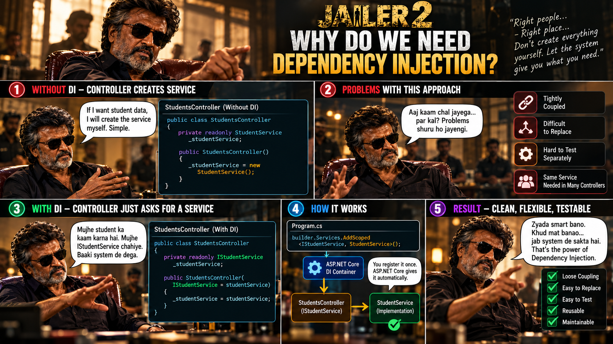

Slide 7
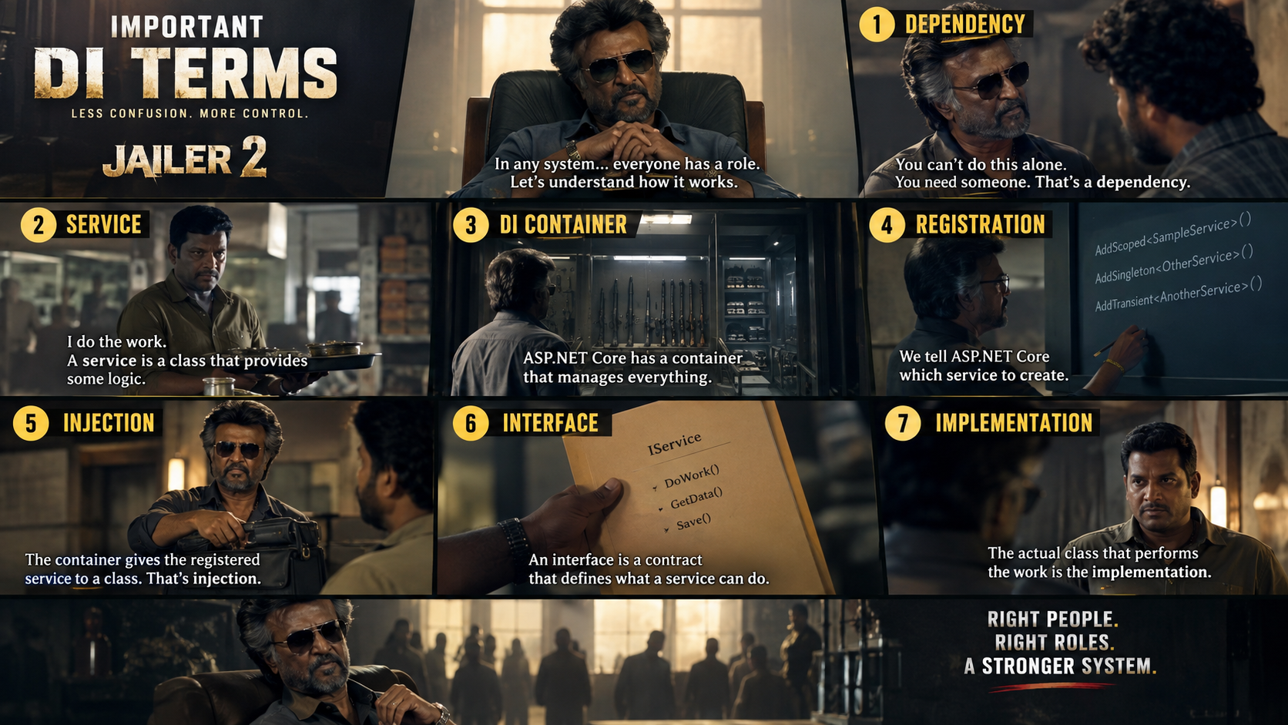

Slide 8
DI Service Lifetimes
When registering a service, we must tell ASP.NET Core how long the service object should live.
There are three main lifetimes:
Lifetime | Meaning | Basic use case
Transient | New object whenever requested | Small, stateless helper
Scoped | One object for one HTTP request | Business services, database work
Singleton | One object for entire app lifetime | Shared read-only/configuration-style service

Slide 9
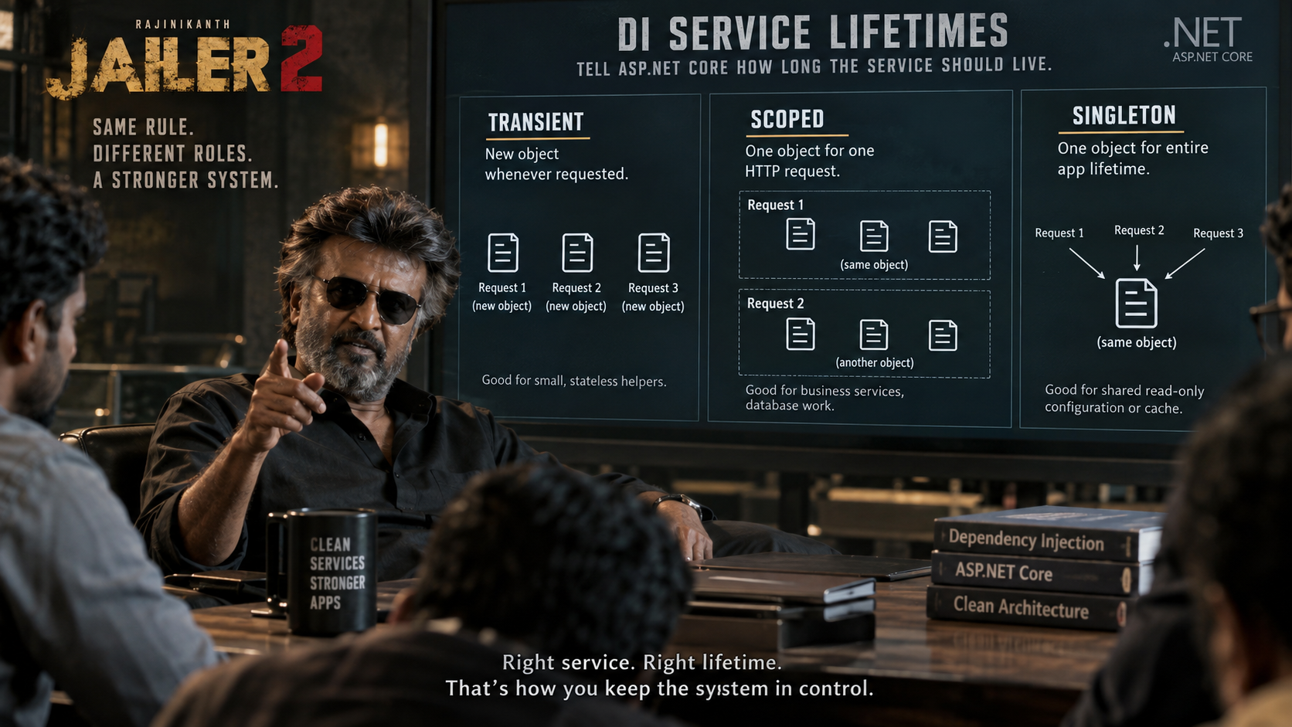

Slide 10
Quick Quiz
What is the primary objective of Dependency Injection in software development?
To increase the execution speed and memory efficiency of compiled applications.
To achieve loose coupling by removing the direct creation of dependencies inside high-level classes.
To completely eliminate the need for writing unit tests.
To force classes to instantiate their own dependent objects internally.
Answer: B

Slide 11
Quick Quiz
How does Dependency Injection significantly improve unit testing?
It allows mocking or stubbing out dependencies by passing fake or surrogate implementations into the class.
It automatically generates all edge-case test assertions for your business logic.
It ensures that all dependencies are hardcoded, preventing tests from failing due to external state changes.
It makes tests run faster by bypassing the compilation phase entirely.
Answer: A

Slide 12
Q&A
The End

